Slide 1
Search project cgs 616
KRITNANDAN

Slide 2
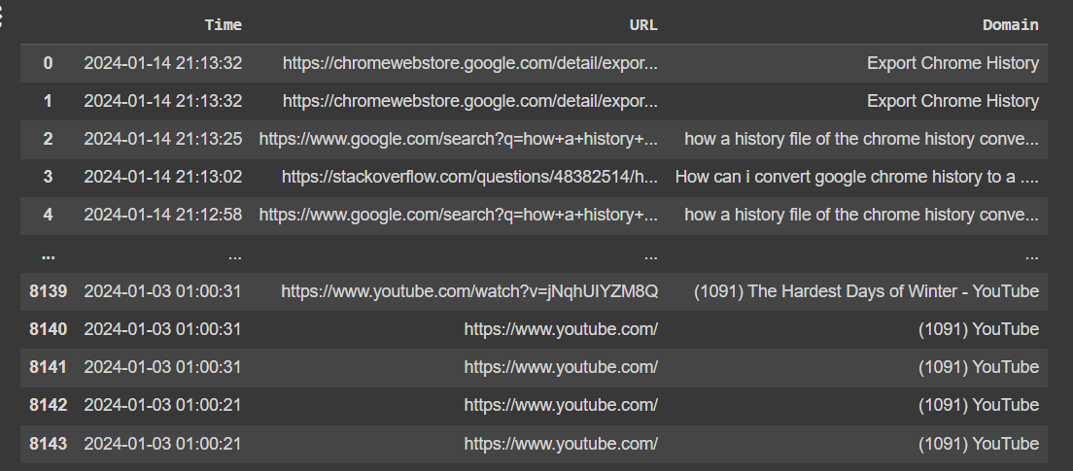
DATASET
Exporting Chrome History by using the sqllite3.exe​
Dropping the columns from data that is not required for further analysis like(id , type count, transition etc.)

Slide 3
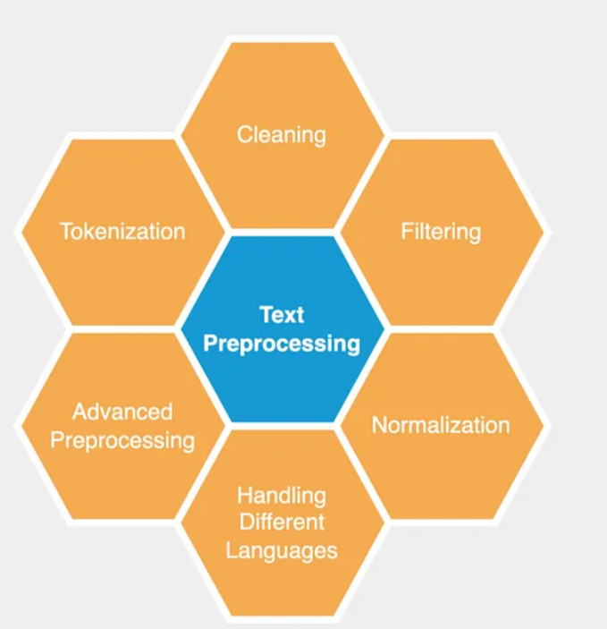
Terms and definitions
.
Text preprocessing in NLP involves cleaning and transforming raw text through tasks like tokenization, lowercasing, punctuation removal, and stop word removal. These techniques standardize text, reduce noise, and enhance the accuracy of NLP tasks like sentiment analysis and text classification. It's crucial for handling real-world text data, improving efficiency in downstream tasks.

Slide 4
Dwell time and transition points
Dwell time signifies the duration users spend on specific web pages before navigating away or closing tabs. Transition points refer to instances when users move between different URLs or web pages within their browsing session. Analyzing these metrics in Chrome history offers insights into user engagement, preferences, and browsing patterns. This data can inform optimizations in content recommendations, browsing experiences, and user interface design within the Chrome browser.

Slide 5
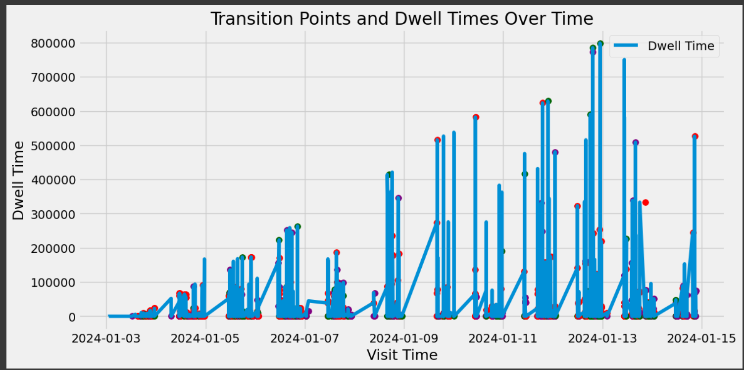
Transition points and dwell time

Slide 6
Initialize a CountVectorizer to convert text documents into a matrix of token counts.
Fit the vectorizer to the documents and transform them into a matrix X.
Apply Latent Dirichlet Allocation (LDA) with 3 components to uncover topics within the documents.
Calculate the cosine similarity matrix to detect transition points where similarity drops below 0.8.
For each transition point, find the dominant topic and its distribution using LDA.
Incorporate dwell time information to weigh topic distributions.
Compile results including transition points, dominant topics, topic distributions, dwell time, and weighted distributions.
Construct a data frame to organize and visualize the transition points and associated metrics.
Plot a line graph showing dwell time over time, with transition points marked by colored markers representing dominant topics.
Utilize distinct colors for each topic and black for transition points to enhance clarity in the presentation.

Slide 7
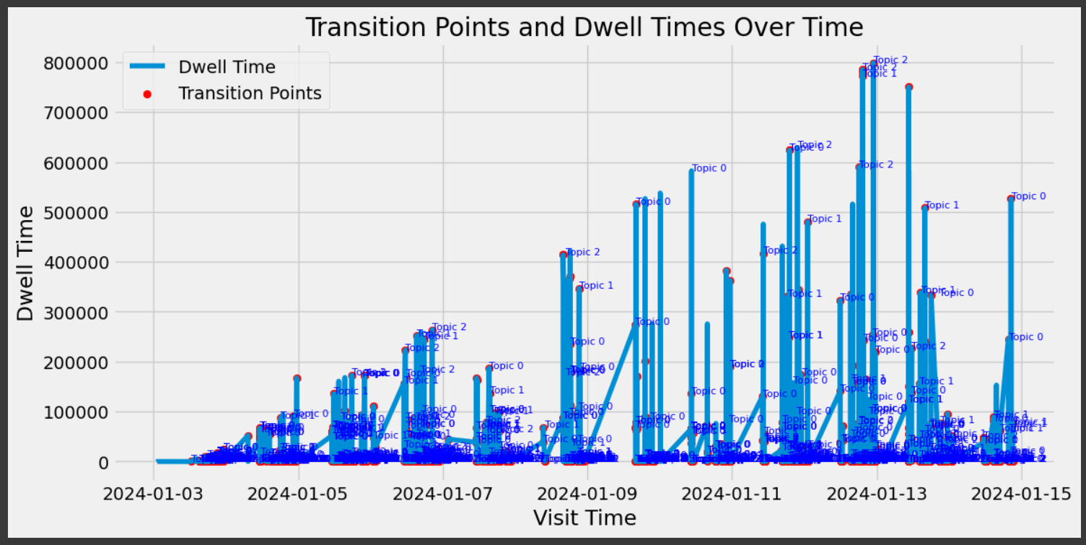
Graph with topic name

Slide 8
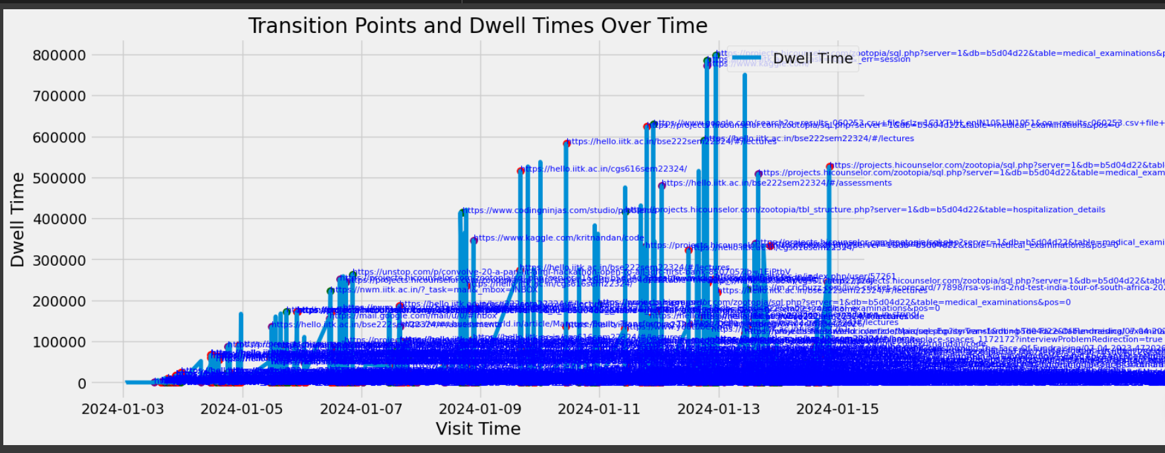
Graph with URL of website

Slide 9
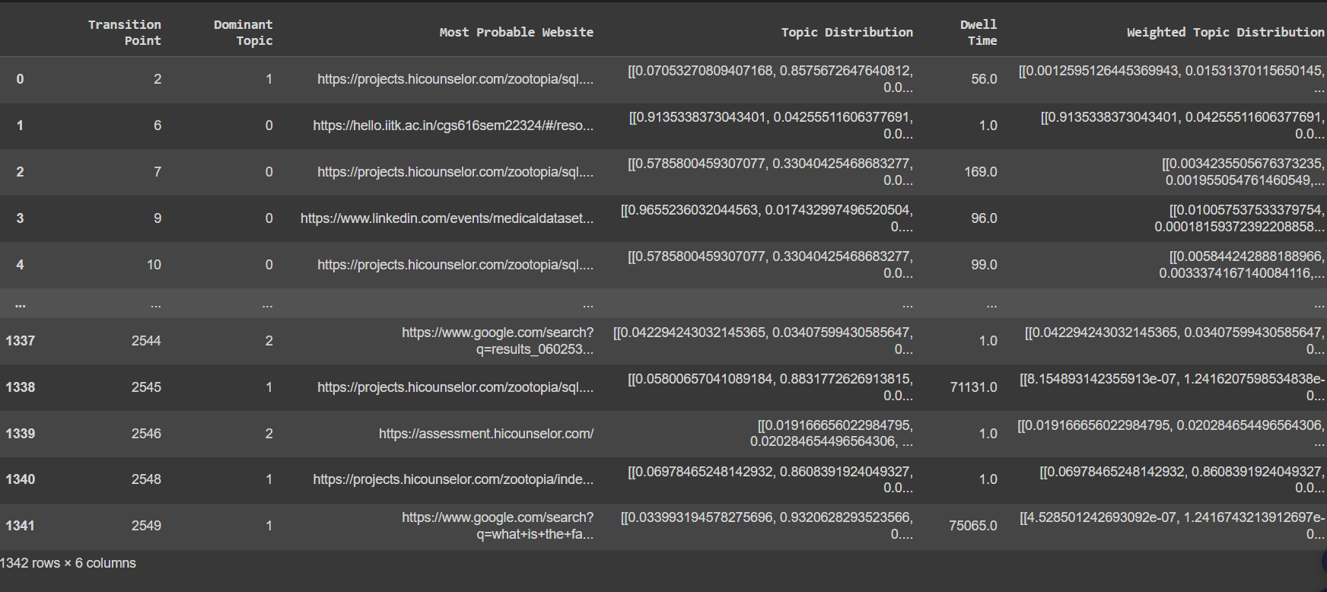
Dataset with topic distribution probability

Slide 10
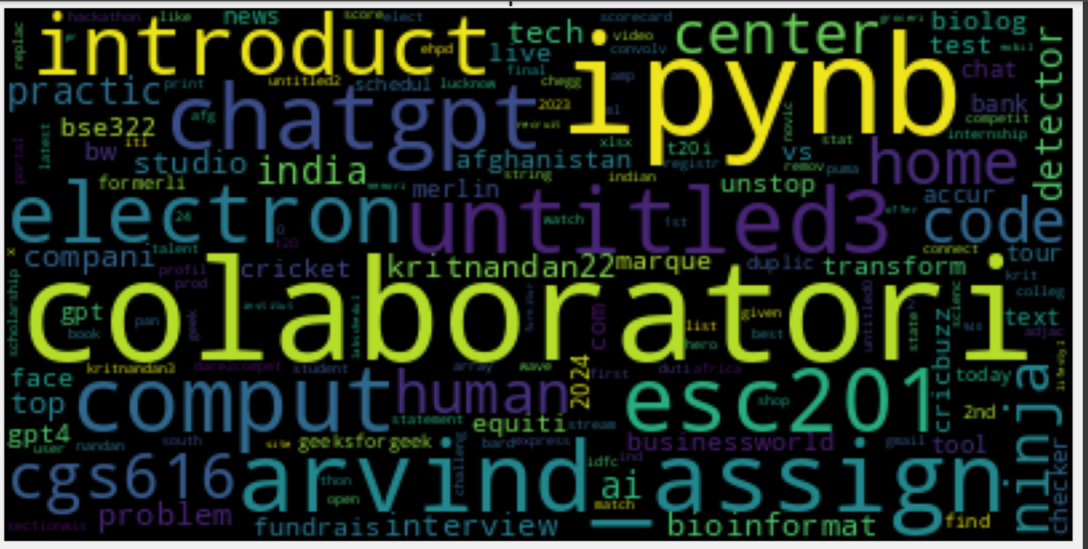
Worldcloud of sample topic #1

Slide 11
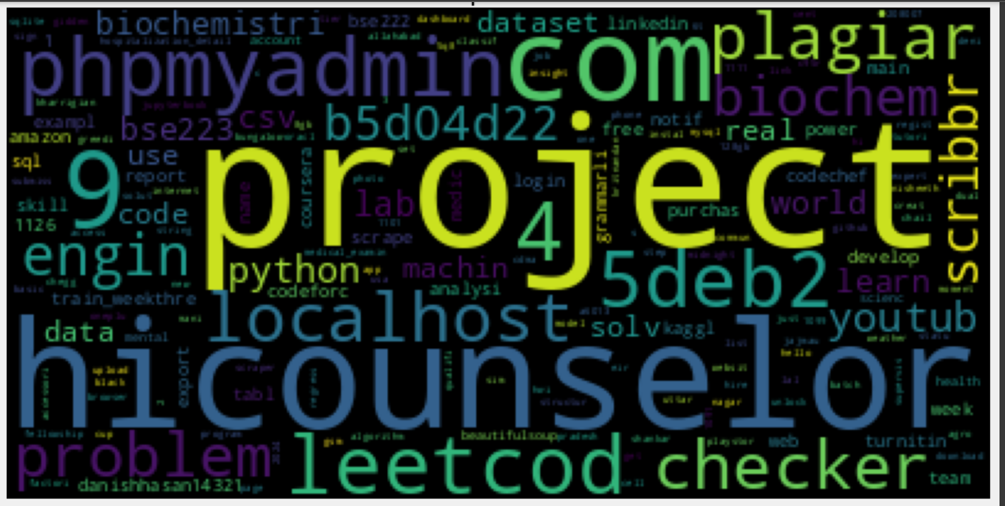
Sample topic #2

Slide 12
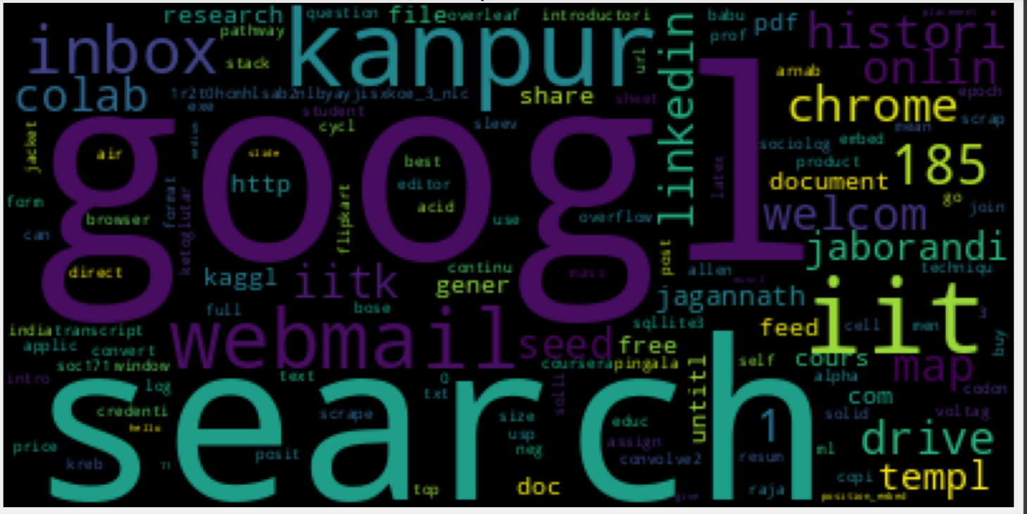
Sample topic #3

Slide 13
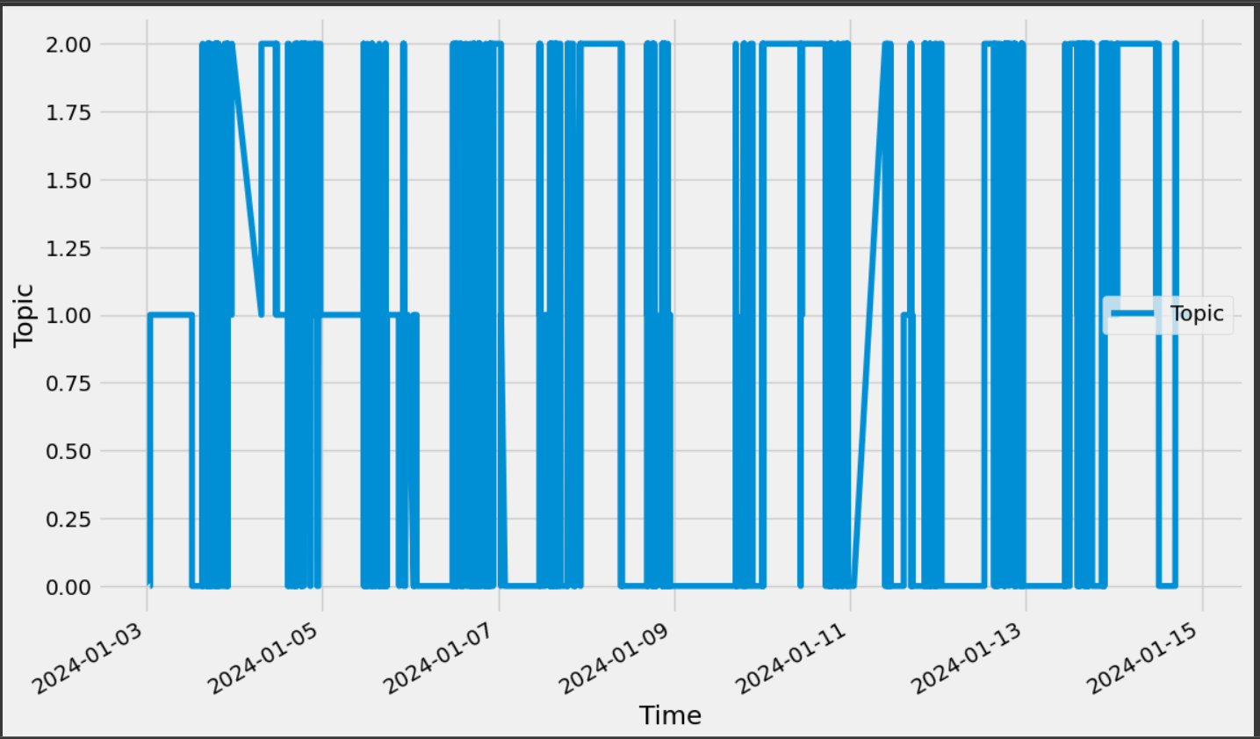
ELEMENTRY TEMPORAL ANALYSIS

Slide 14
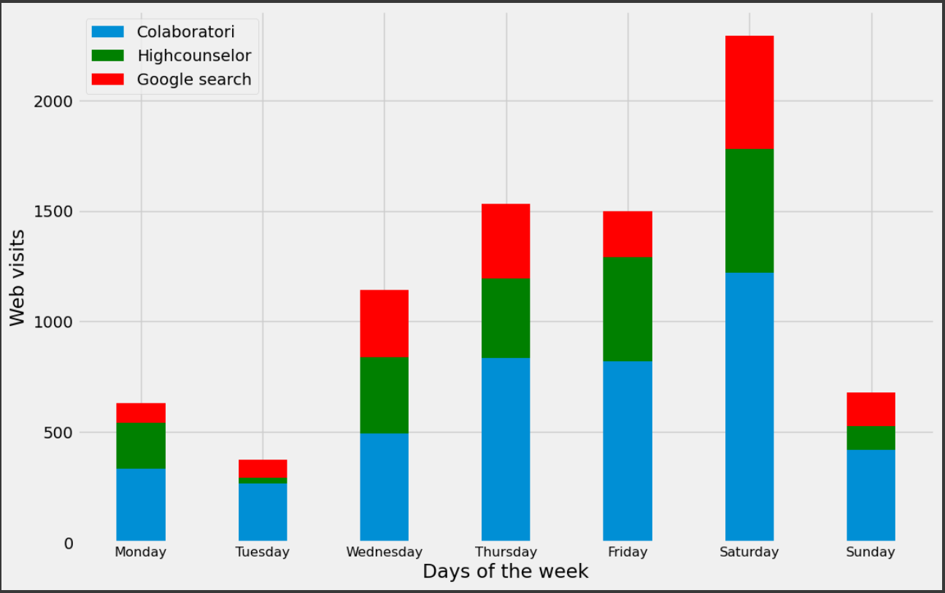
ELEMENTRY COUNT ANALYSIS

Slide 15
Thank you
Kritnandan
https://www.linkedin.com/in/krit-nandan-633b5324b/
kritnandan22@iitk.ac.in
kritnandan3@gmail.com

